Slide 1


Giga Puzzles
Issues 1-27

Slide 2
Description of Levels
Club | Description | Approximate ECF Grade *
DECA – Club | Complete beginners and those with an incomplete grasp of the rules | Ungraded
MEGA – Club | Know the rules but little grasp of planning what to do beyond capturing and quick checkmates. Little to no tournament experience | 0 – 59
GIGA – Club | Players with some tournament experience looking to “level up” | 60 – 99
TERA – Club | More experienced players who have won or placed highly in local competitions | 100 – 129
EXA - Club | Very experienced players with success at National Level events | 130 – 159

Slide 3
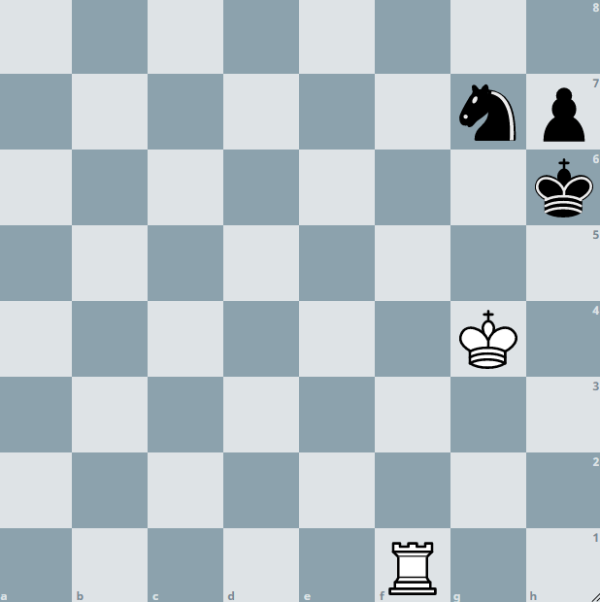
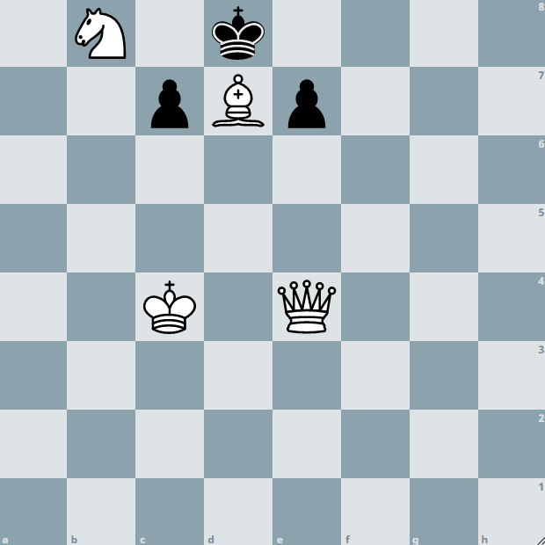
Example
Below are examples of how you might write your solution to a puzzle presented in the booklet. Or you might prefer to just solve them in your head – completely up to you!
Q: Can you find checkmate in one for white?
Here, because the solution is only one move, you might draw arrows on the board or you can use the lines below to answer – or both!
8
7
6
5
4
3
2
1
a b c d e f g h
Rf6#
…………………………………………………………………………………………………………
Q: Can you find checkmate in two for white?
Here, the solution is a bit (OK a lot!) trickier and requires consideration of multiple variations. If you are familiar with coordinates, it is probably best that you write your answer out as shown.
8
7
6
5
4
3
2
1
a b c d e f g h
1.Qe1 e6 (1..c6 2.Qa5#) 2. Qh4#
…………………………………………………………………………………………………………

Slide 4
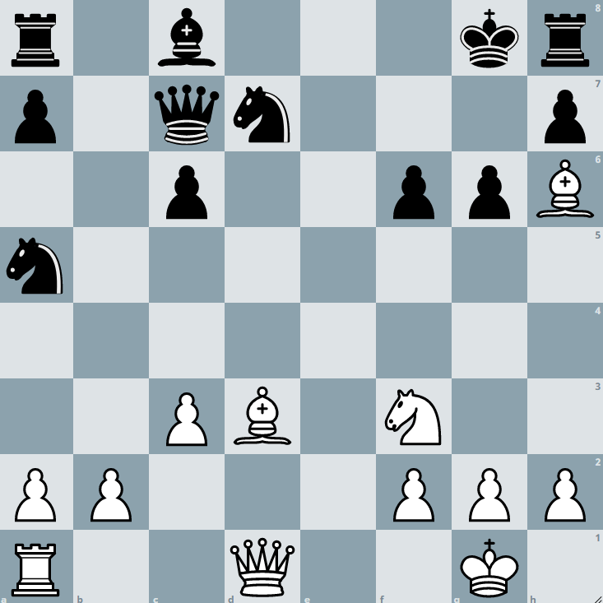
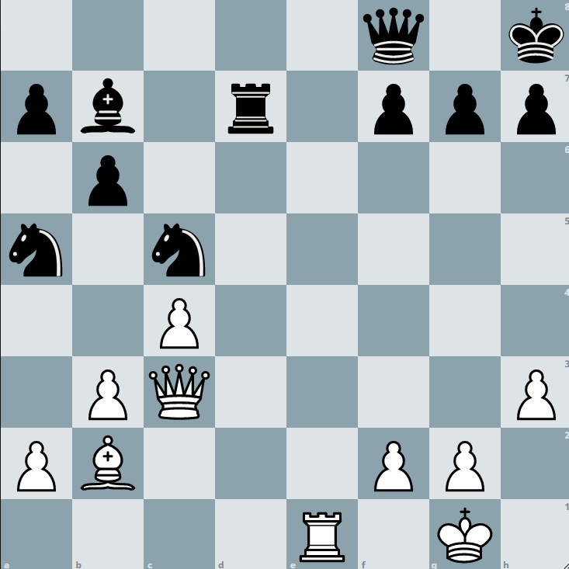
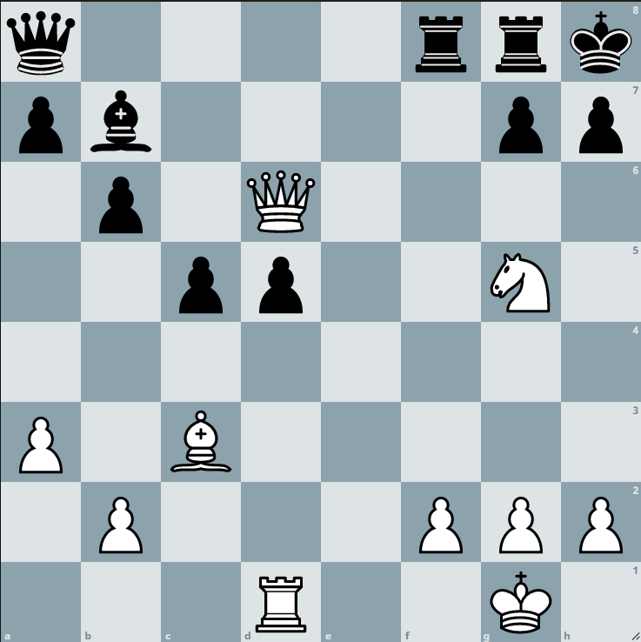
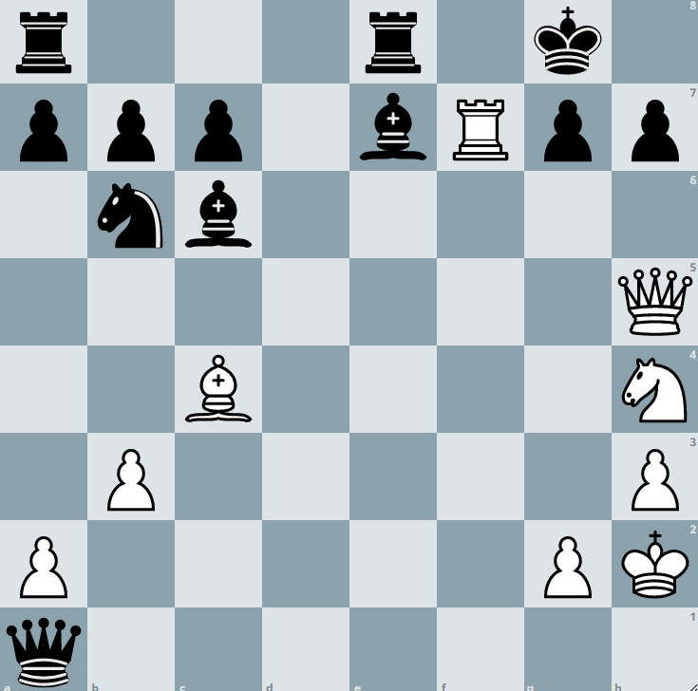
Giga
You’ll be familiar with checkmates in one, but much harder are checkmates in two! There are many more ways to make two moves than to make one!
Write the solutions to these checkmates in two below. So you have to find white’s first move, blacks best defence and then white’s winning move.
1
8
7
6
5
4
3
2
1
3
8
7
6
5
4
3
2
1
a b c d e f g h
a b c d e f g h
…………………………………………………………………………………………………………
…………………………………………………………………………………………………………
2
8
7
6
5
4
3
2
1
4
8
7
6
5
4
3
2
1
a b c d e f g h
a b c d e f g h
…………………………………………………………………………………………………………
…………………………………………………………………………………………………………

Slide 5
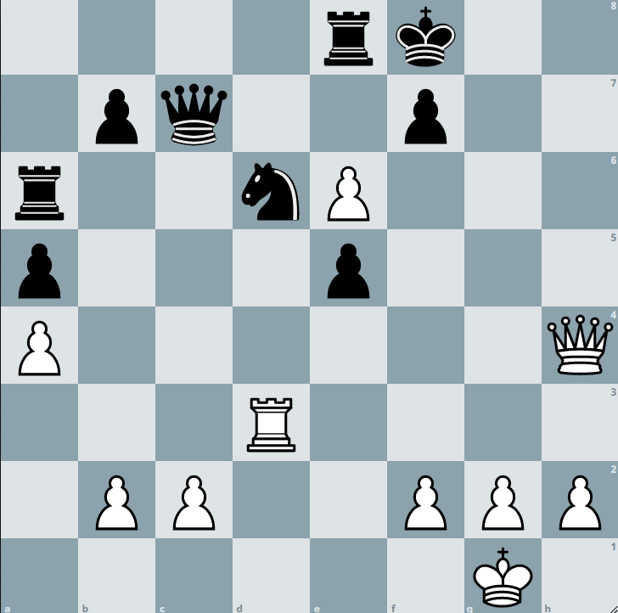
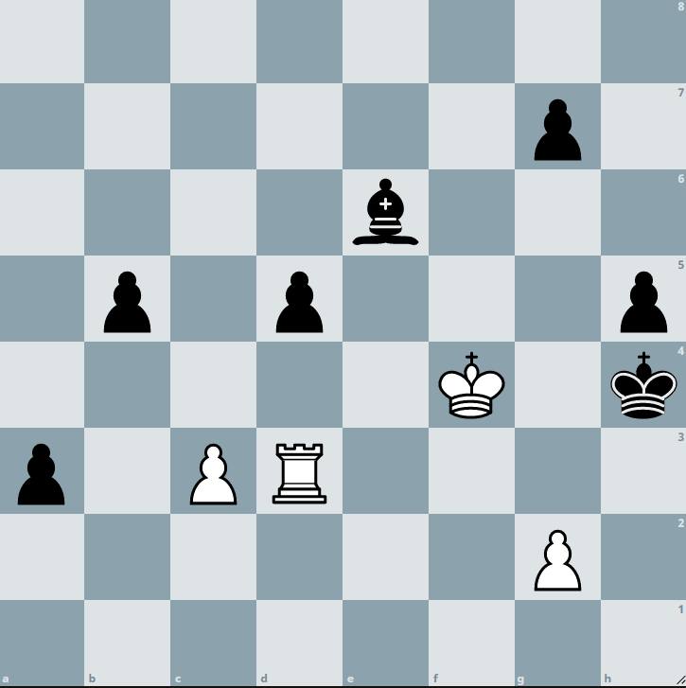
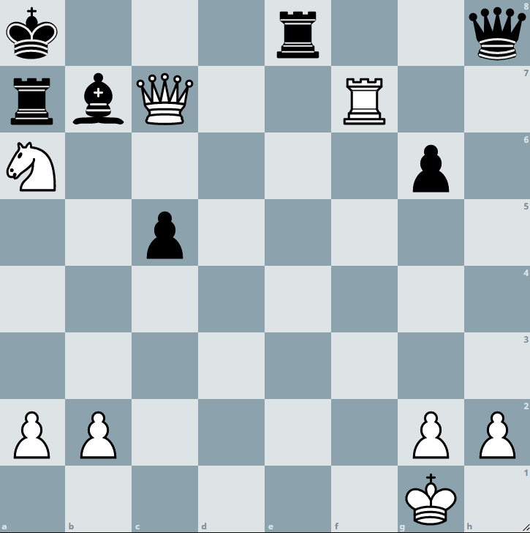
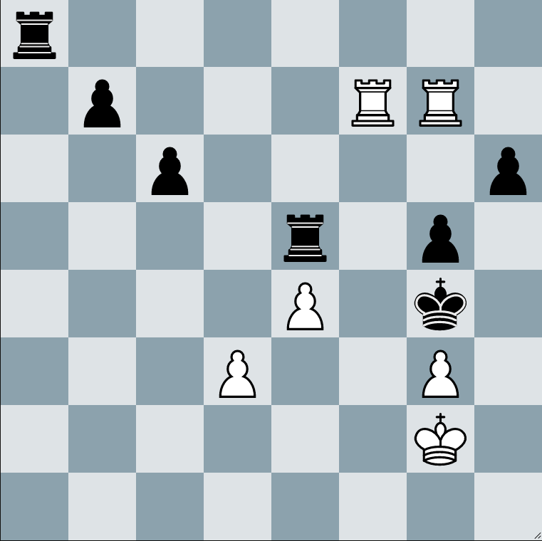
Giga
In the diagrams below it is white play. You have to lure a defender into the escape path of the black king to create a type of “smothered mate”!
Beware – puzzle 4 is a mate in 3 (the others are mate in 2)!
1
8
7
6
5
4
3
2
1
3
8
7
6
5
4
3
2
1
a b c d e f g h
a b c d e f g h
…………………………………………………………………………………………………………
…………………………………………………………………………………………………………
2
8
7
6
5
4
3
2
1
4
8
7
6
5
4
3
2
1
a b c d e f g h
a b c d e f g h
…………………………………………………………………………………………………………
…………………………………………………………………………………………………………

Slide 6
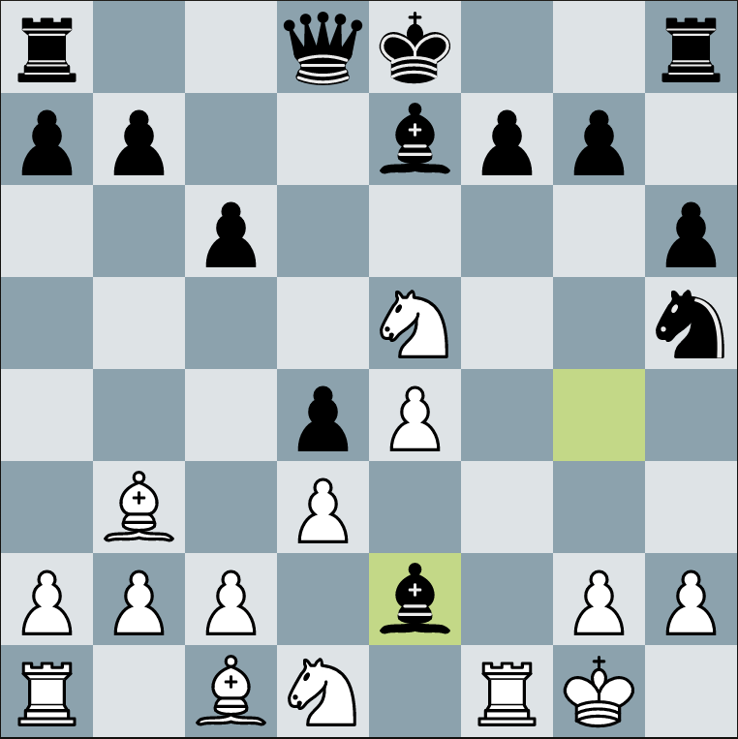
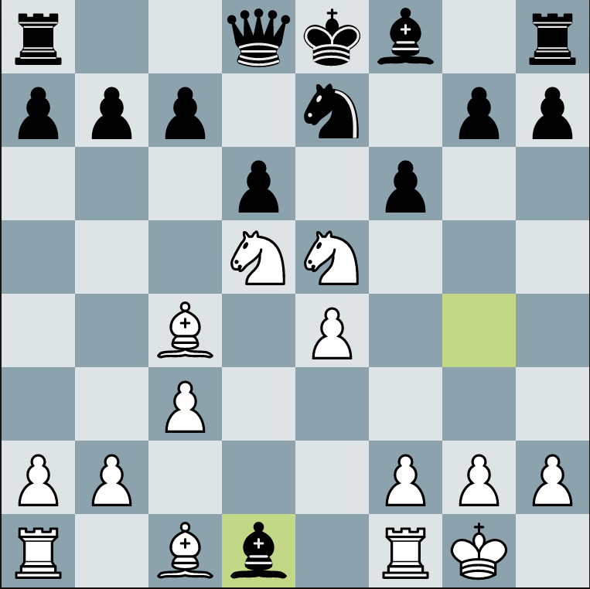
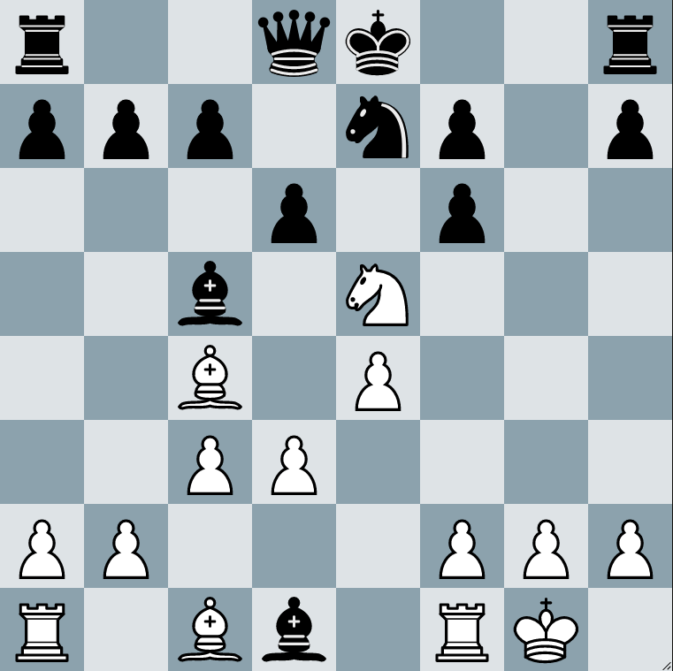
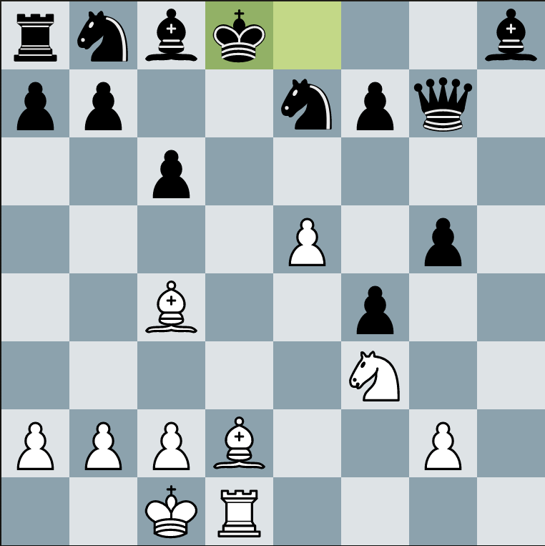
Giga
In the diagrams below it is white play and checkmate in 2 moves (ie white moves, black plays the best defensive move and white checkmates with their second move).
Be alert, a double check is required to solve one of the puzzles!
1
8
7
6
5
4
3
2
1
3
8
7
6
5
4
3
2
1
a b c d e f g h
a b c d e f g h
…………………………………………………………………………………………………………
…………………………………………………………………………………………………………
2
8
7
6
5
4
3
2
1
4
8
7
6
5
4
3
2
1
a b c d e f g h
a b c d e f g h
…………………………………………………………………………………………………………
…………………………………………………………………………………………………………

Slide 7
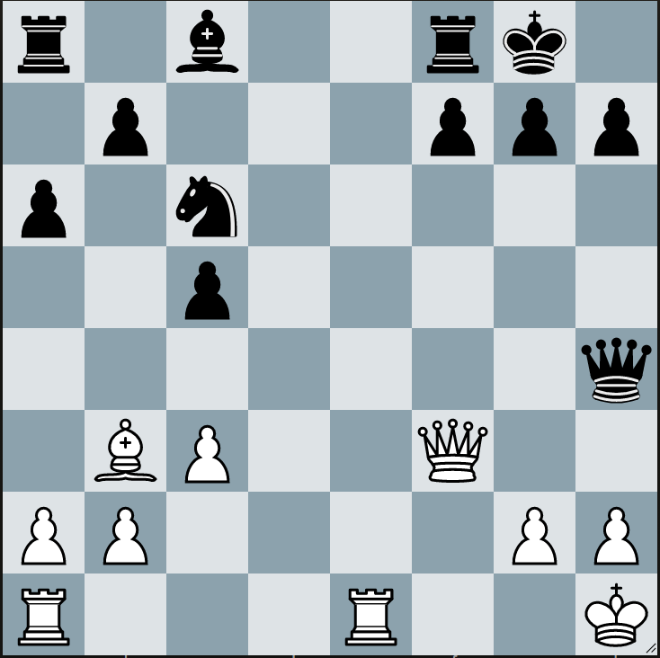
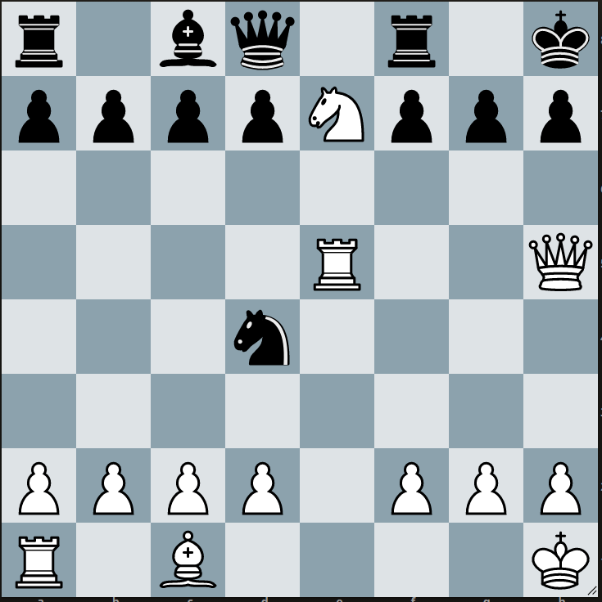
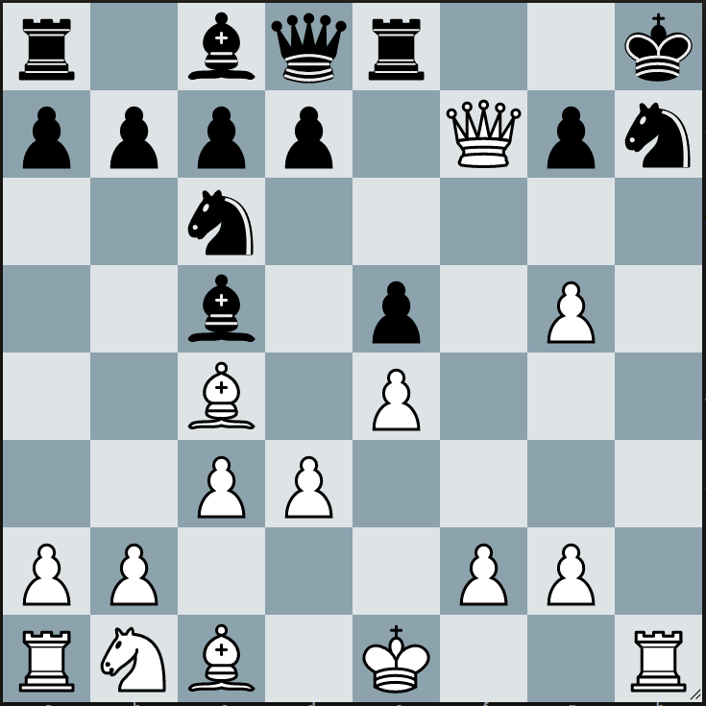
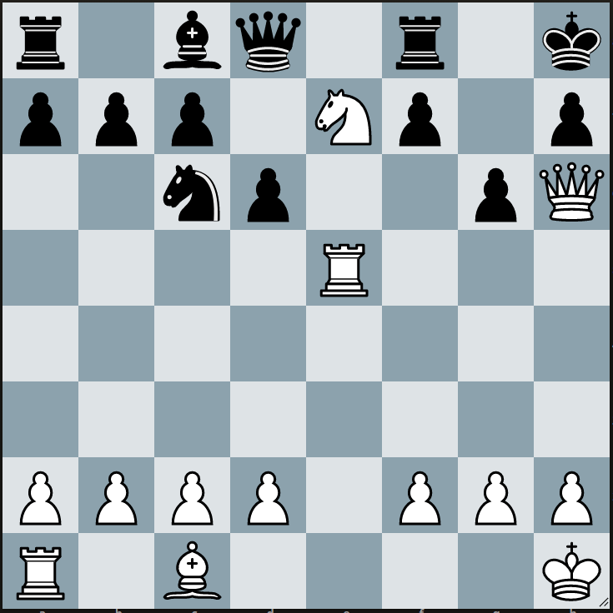
Giga
In the diagrams below it is white play and checkmate in 2 moves (ie white moves, black plays the best defensive move and white checkmates with their second move).
In question 4 the first move is not a check – it is a “quiet move”.
1
8
7
6
5
4
3
2
1
3
8
7
6
5
4
3
2
1
a b c d e f g h
a b c d e f g h
…………………………………………………………………………………………………………
…………………………………………………………………………………………………………
2
8
7
6
5
4
3
2
1
4
8
7
6
5
4
3
2
1
a b c d e f g h
a b c d e f g h
…………………………………………………………………………………………………………
…………………………………………………………………………………………………………

Slide 8
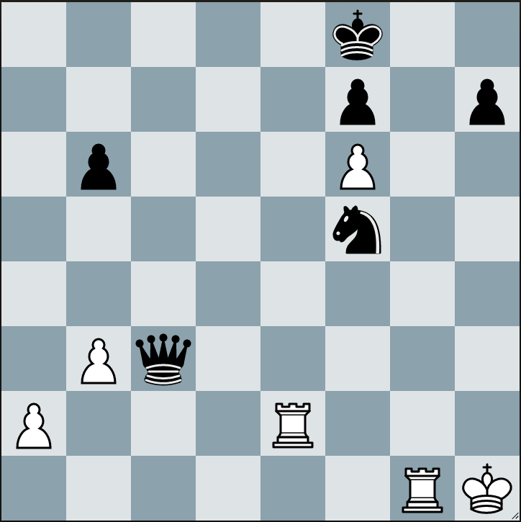
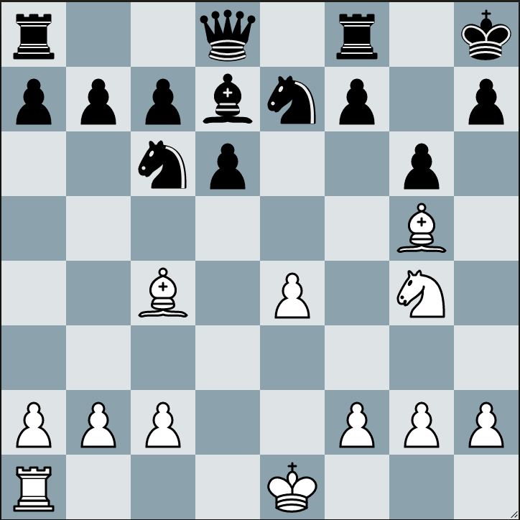
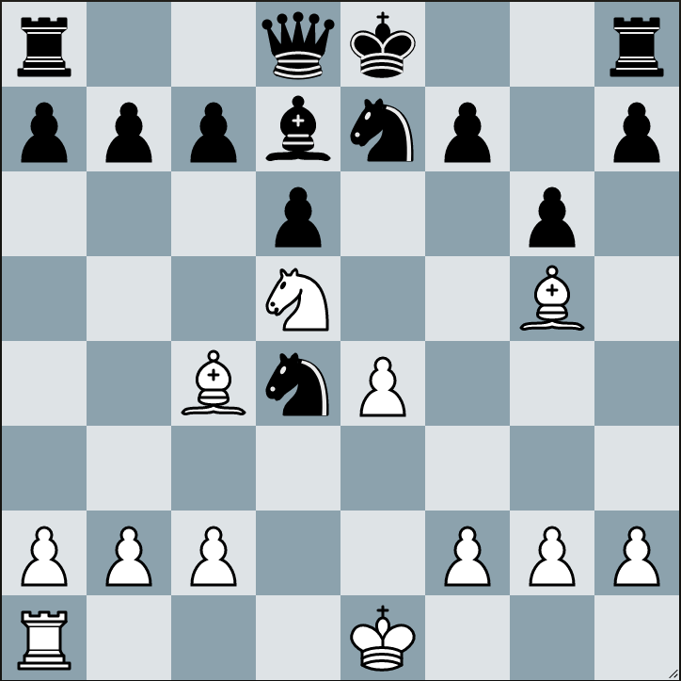
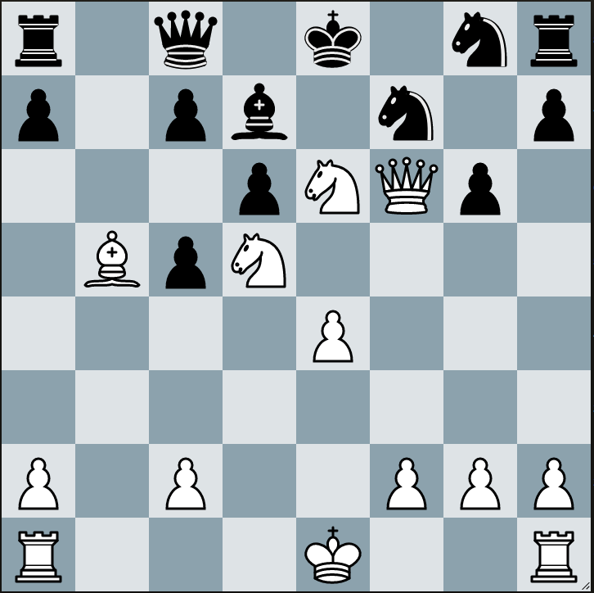
Giga
In the diagrams below it is white play and checkmate in 2 moves (ie white moves, black plays the best defensive move and white checkmates with their second move).
1
8
7
6
5
4
3
2
1
3
8
7
6
5
4
3
2
1
a b c d e f g h
a b c d e f g h
…………………………………………………………………………………………………………
…………………………………………………………………………………………………………
2
8
7
6
5
4
3
2
1
4
8
7
6
5
4
3
2
1
a b c d e f g h
a b c d e f g h
…………………………………………………………………………………………………………
…………………………………………………………………………………………………………

Slide 9
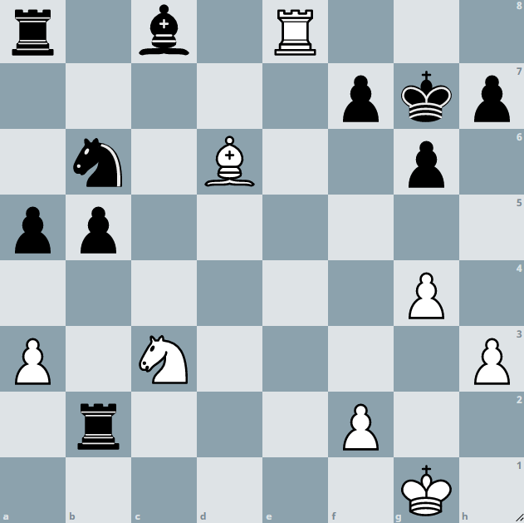
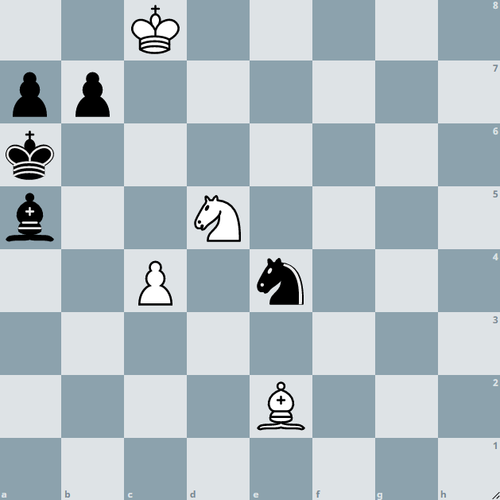
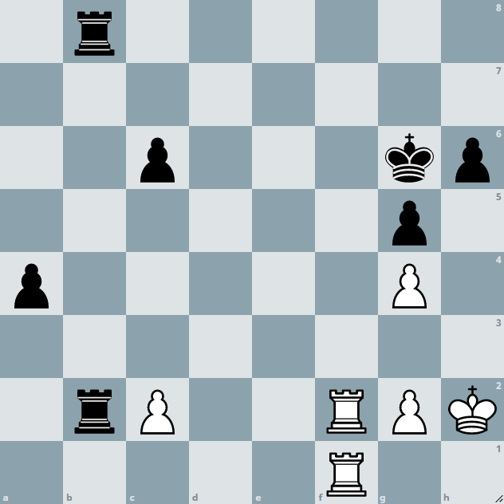
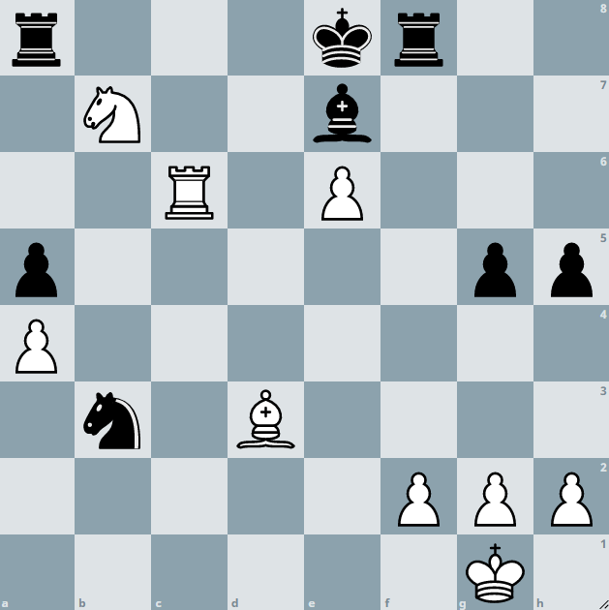
Giga
In the diagrams below it is white play and checkmate in 2 moves. In two puzzles the first move is not a check and in another you will need to use en-passant!
1
8
7
6
5
4
3
2
1
3
8
7
6
5
4
3
2
1
a b c d e f g h
a b c d e f g h
…………………………………………………………………………………………………………
…………………………………………………………………………………………………………
2
8
7
6
5
4
3
2
1
4
8
7
6
5
4
3
2
1
a b c d e f g h
a b c d e f g h
…………………………………………………………………………………………………………
…………………………………………………………………………………………………………

Slide 10
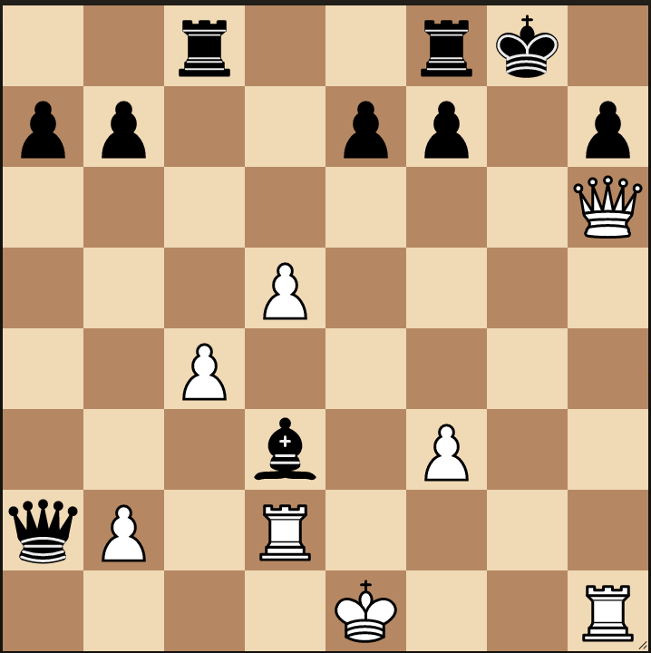
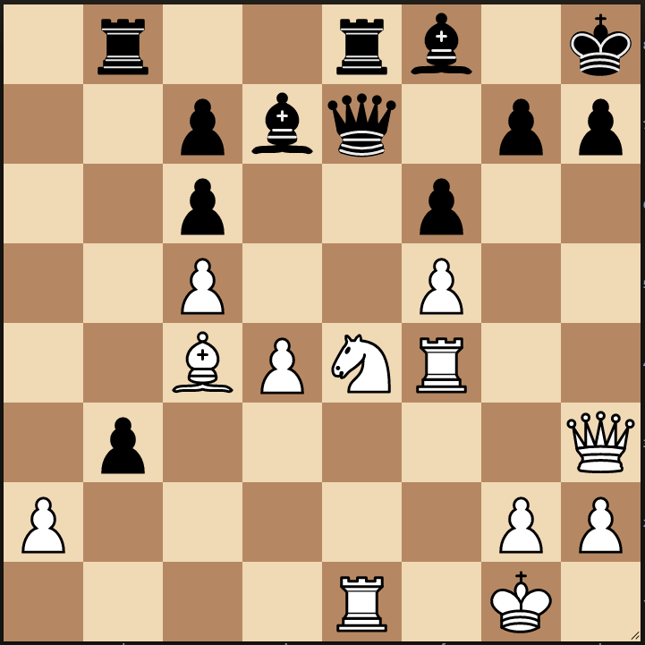
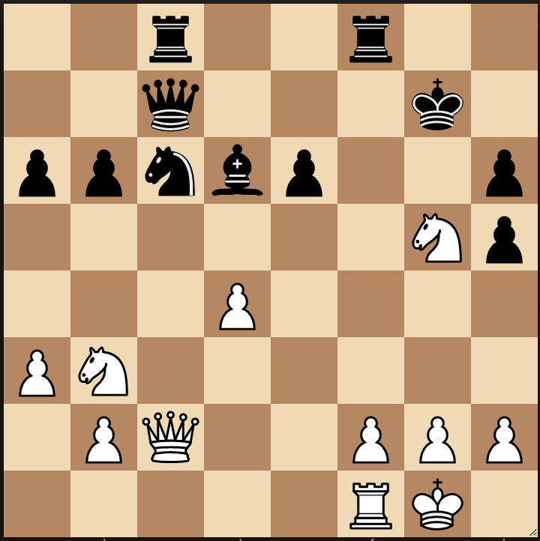
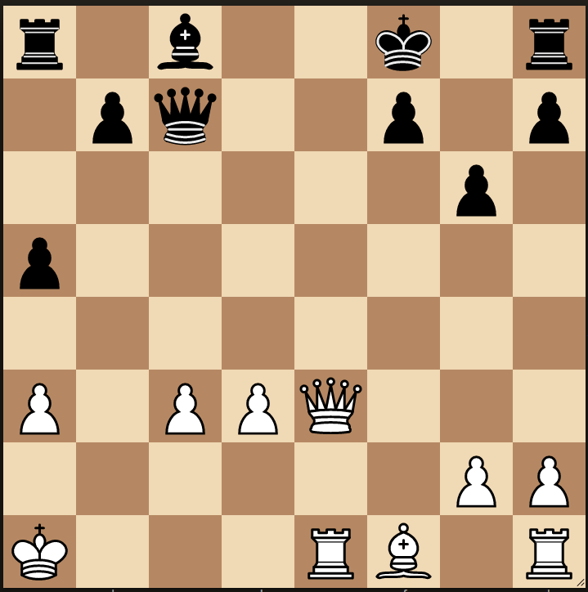
Giga
In each diagram it is white to move and checkmate black in two moves (two moves for white, one for black).
1
8
7
6
5
4
3
2
1
3
8
7
6
5
4
3
2
1
a b c d e f g h
a b c d e f g h
…………………………………………………………………………………………………………
…………………………………………………………………………………………………………
2
8
7
6
5
4
3
2
1
4
8
7
6
5
4
3
2
1
a b c d e f g h
a b c d e f g h
…………………………………………………………………………………………………………
…………………………………………………………………………………………………………

Slide 11
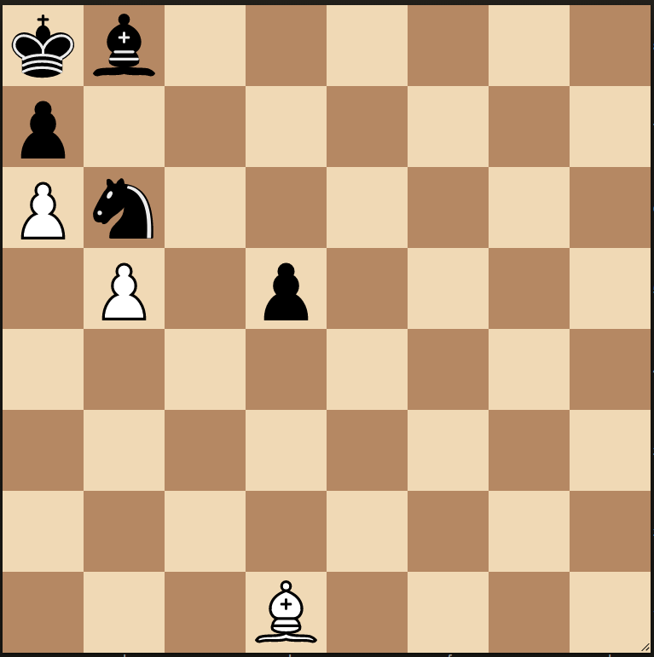
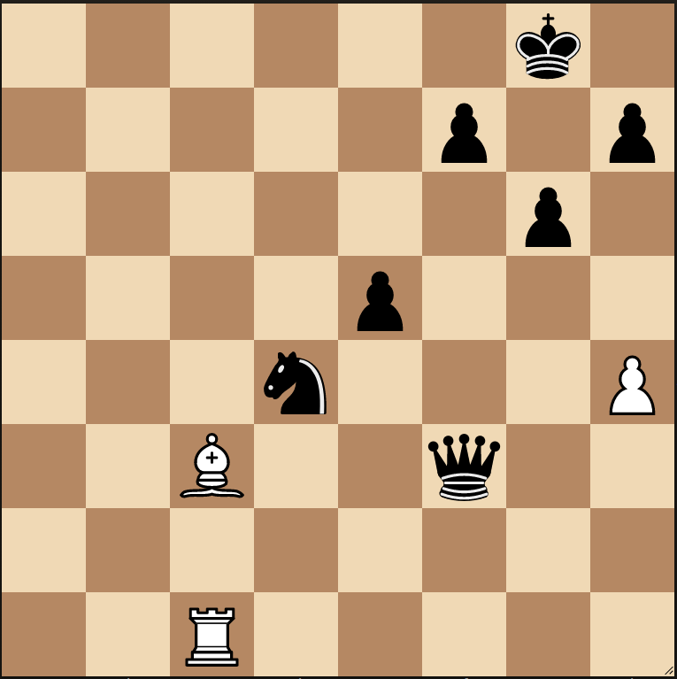
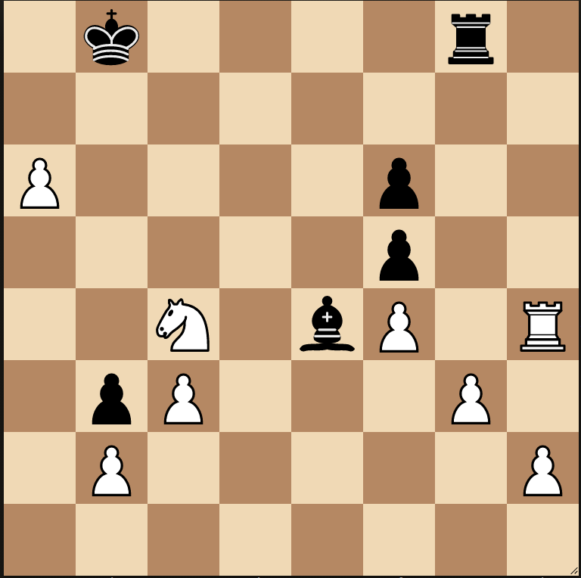
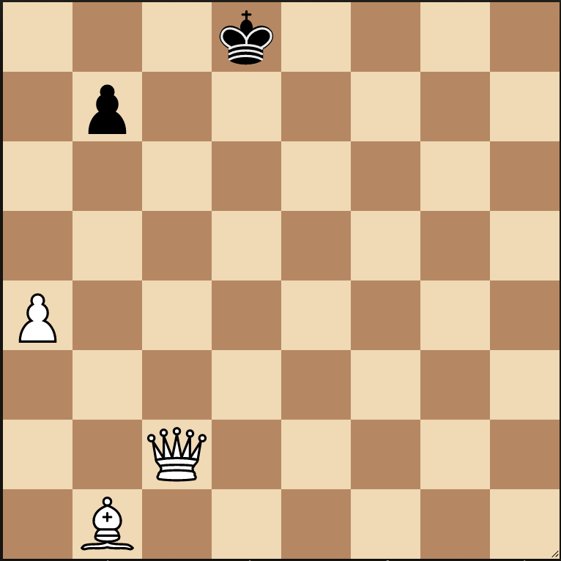
Giga
White needs to make three consecutive moves to place black in checkmate.
White may not capture a piece, move to an unprotected square and can only deliver a check on the final move.
1
8
7
6
5
4
3
2
1
3
8
7
6
5
4
3
2
1
a b c d e f g h
a b c d e f g h
…………………………………………………………………………………………………………
…………………………………………………………………………………………………………
2
8
7
6
5
4
3
2
1
4
8
7
6
5
4
3
2
1
a b c d e f g h
a b c d e f g h
…………………………………………………………………………………………………………
…………………………………………………………………………………………………………

Slide 12
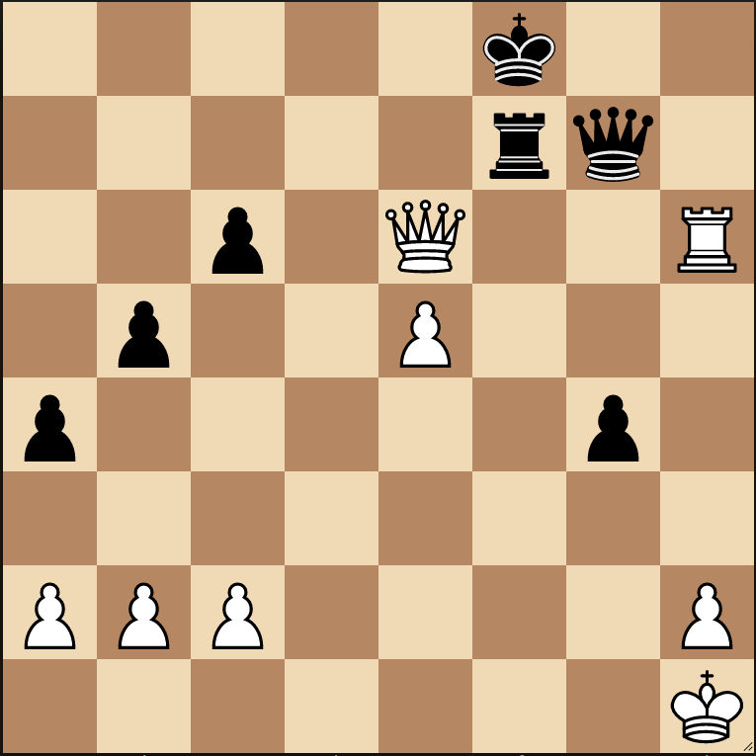
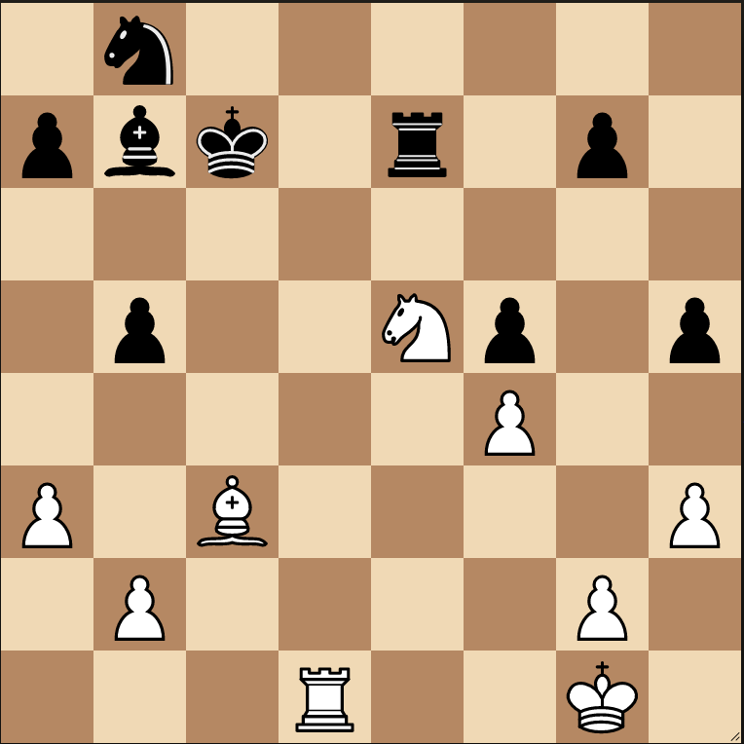
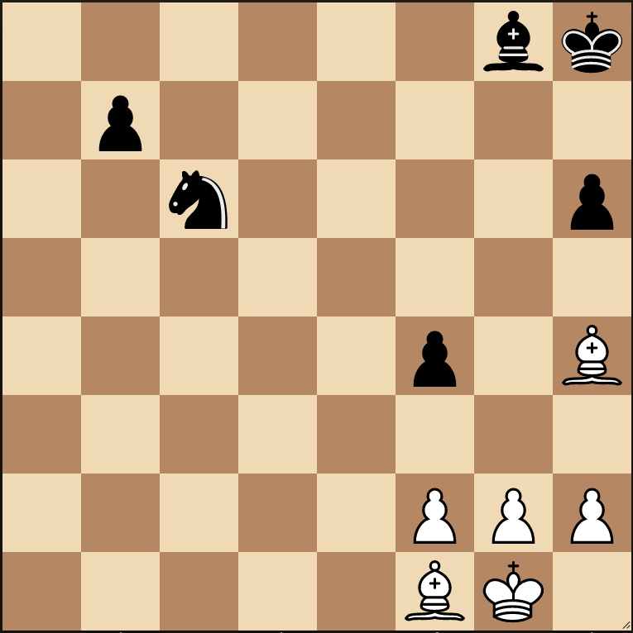
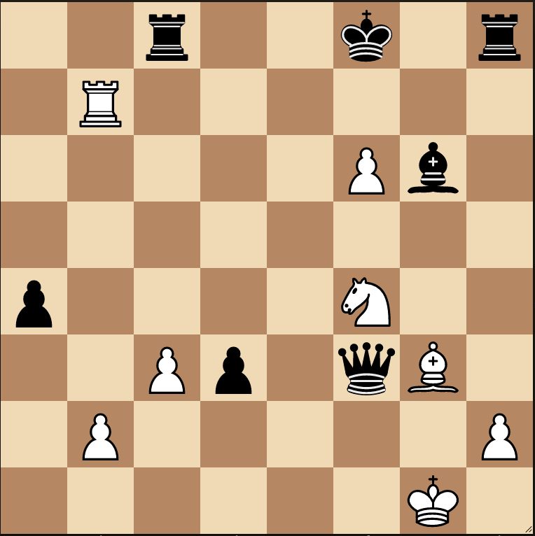
Giga
White to play and checkmate in two moves (2 moves from white, one by black).
1
8
7
6
5
4
3
2
1
3
8
7
6
5
4
3
2
1
a b c d e f g h
a b c d e f g h
…………………………………………………………………………………………………………
…………………………………………………………………………………………………………
2
8
7
6
5
4
3
2
1
4
8
7
6
5
4
3
2
1
a b c d e f g h
a b c d e f g h
…………………………………………………………………………………………………………
…………………………………………………………………………………………………………

Slide 13
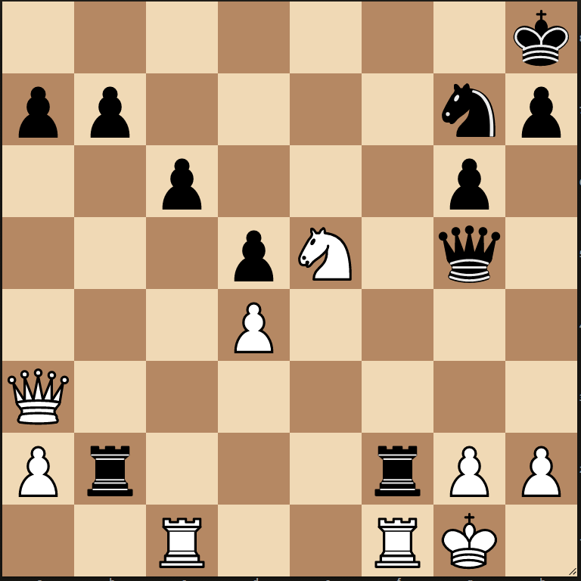
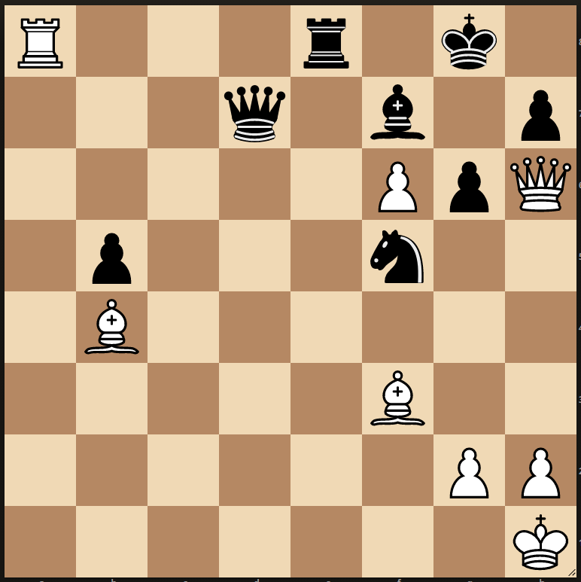
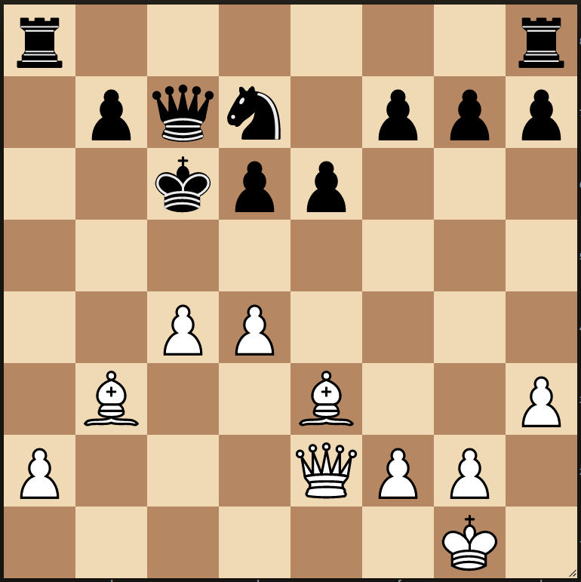
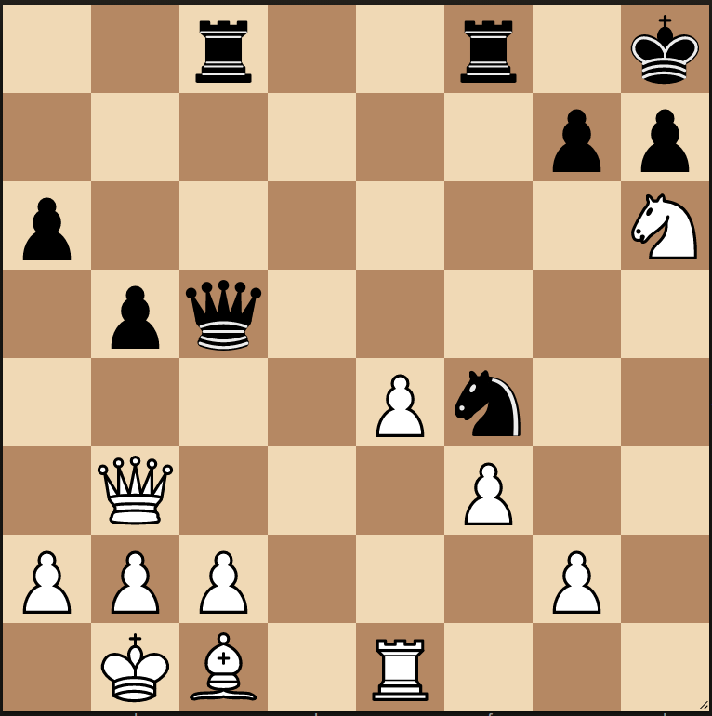
Giga
White to play and checkmate in two moves (2 moves from white, one by black).
1
8
7
6
5
4
3
2
1
3
8
7
6
5
4
3
2
1
a b c d e f g h
a b c d e f g h
…………………………………………………………………………………………………………
…………………………………………………………………………………………………………
2
8
7
6
5
4
3
2
1
4
8
7
6
5
4
3
2
1
a b c d e f g h
a b c d e f g h
…………………………………………………………………………………………………………
…………………………………………………………………………………………………………

Slide 14
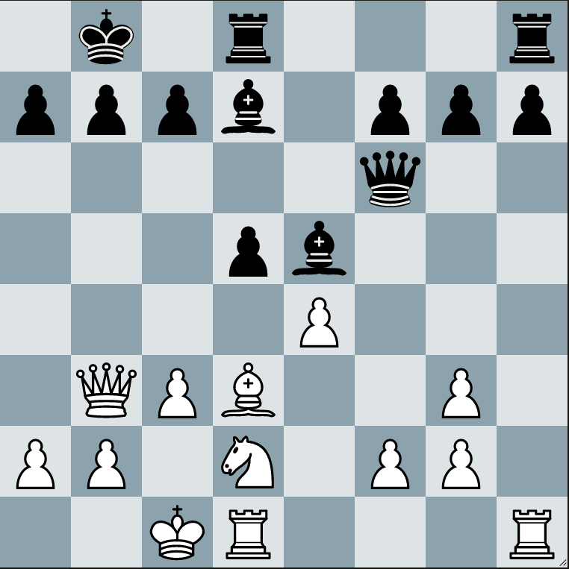
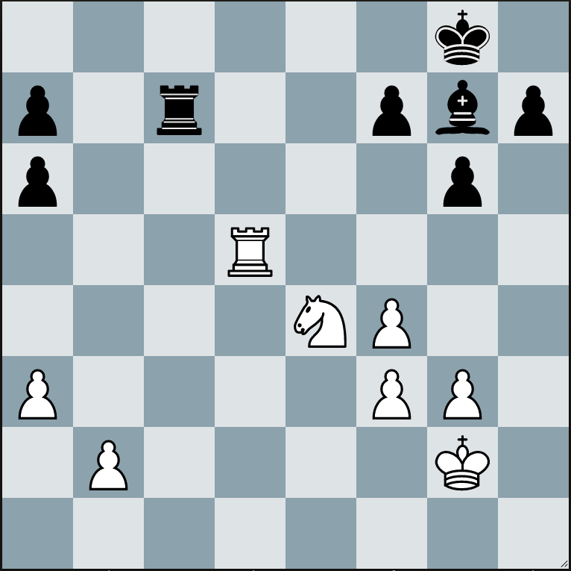
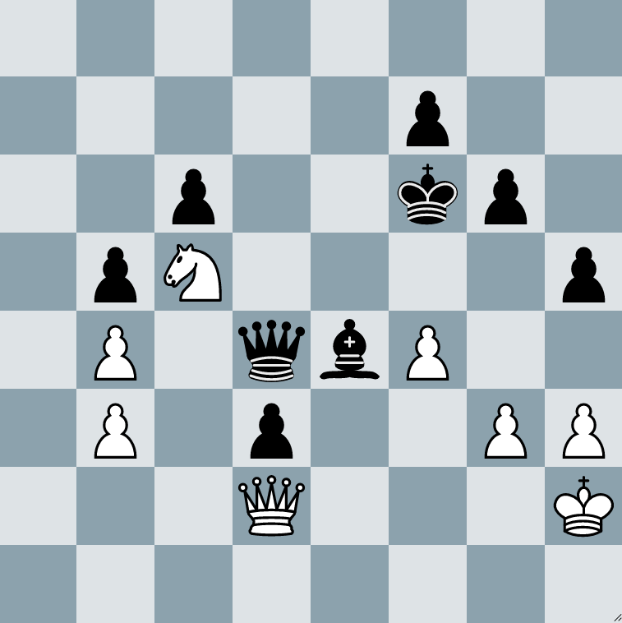
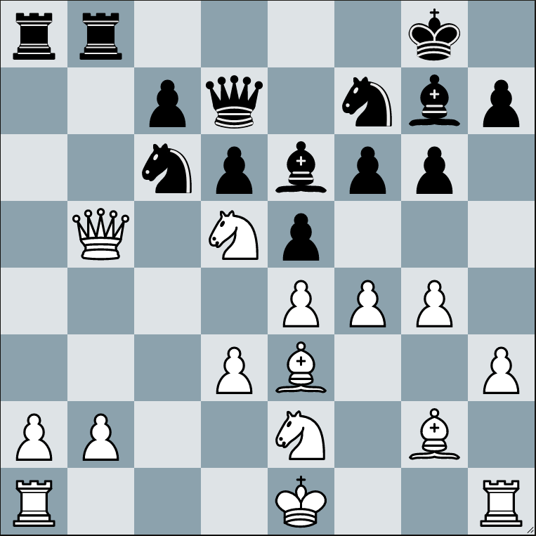
Giga
In the diagrams below it is white play. Your task is to find a move which wins material. The theme of the puzzles is “Double Attack”.
A Double Attack (or “Fork”) is perhaps the most common tactic in chess and is essential for players of all levels to understand.
1
8
7
6
5
4
3
2
1
3
8
7
6
5
4
3
2
1
a b c d e f g h
a b c d e f g h
…………………………………………………………………………………………………………
…………………………………………………………………………………………………………
2
8
7
6
5
4
3
2
1
4
8
7
6
5
4
3
2
1
a b c d e f g h
a b c d e f g h
…………………………………………………………………………………………………………
…………………………………………………………………………………………………………

Slide 15
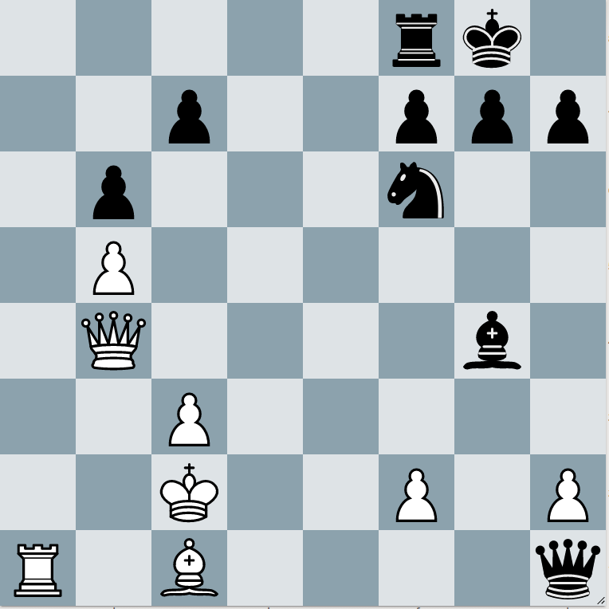
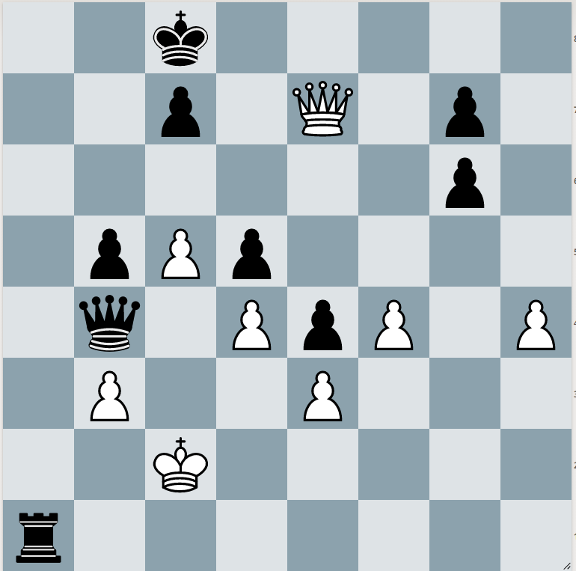
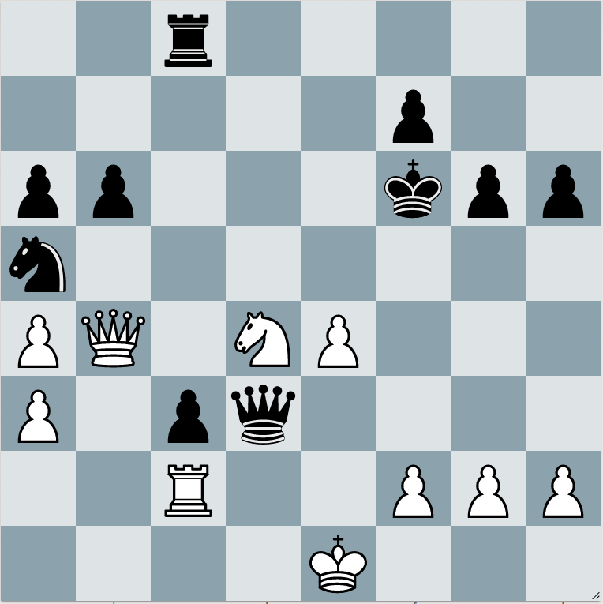
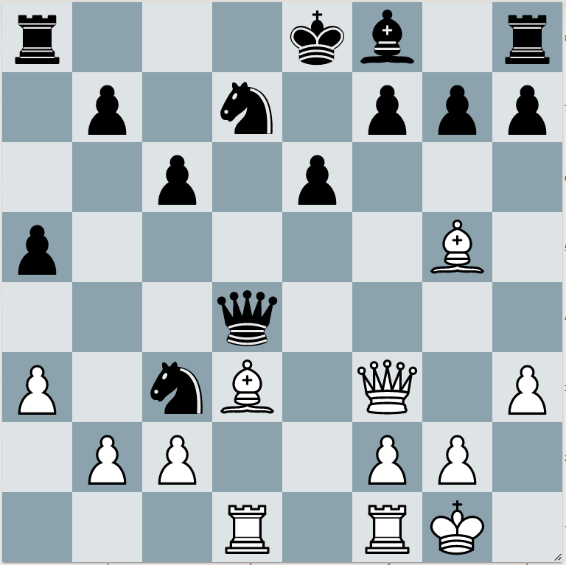
Giga
In the diagrams below it is white play. Your task is to find a move which wins material or leads to a mating attack. The theme of the puzzles is “Discovered Attack”.
In a Discovered Attack the front piece moves out of the way to reveal an attack by a piece behind it. If the front piece also attacks a piece then this is a form of double attack.
1
8
7
6
5
4
3
2
1
3
8
7
6
5
4
3
2
1
a b c d e f g h
a b c d e f g h
…………………………………………………………………………………………………………
…………………………………………………………………………………………………………
2
8
7
6
5
4
3
2
1
4
8
7
6
5
4
3
2
1
a b c d e f g h
a b c d e f g h
…………………………………………………………………………………………………………
…………………………………………………………………………………………………………

Slide 16




Giga
In each diagram it is white to move and win material. Black has played the opening badly and now white can pounce.
1
8
7
6
5
4
3
2
1
3
8
7
6
5
4
3
2
1
a b c d e f g h
a b c d e f g h
…………………………………………………………………………………………………………
…………………………………………………………………………………………………………
2
8
7
6
5
4
3
2
1
4
8
7
6
5
4
3
2
1
a b c d e f g h
a b c d e f g h
…………………………………………………………………………………………………………
…………………………………………………………………………………………………………

Slide 17




Giga
In each diagram it is white to move and there are 2 possible ways to create a fork (remember a fork can attack a piece and threaten checkmate). Show both forks and write which is the best one. Show black’s defence to the inferior move.
1
8
7
6
5
4
3
2
1
3
8
7
6
5
4
3
2
1
a b c d e f g h
a b c d e f g h
…………………………………………………………………………………………………………
…………………………………………………………………………………………………………
2
8
7
6
5
4
3
2
1
4
8
7
6
5
4
3
2
1
a b c d e f g h
a b c d e f g h
…………………………………………………………………………………………………………
…………………………………………………………………………………………………………

Slide 18




Giga
In these puzzles it is white to play and win material, this time you’re not looking for checkmates, just tactics that will get you to a winning position!
1
8
7
6
5
4
3
2
1
3
8
7
6
5
4
3
2
1
a b c d e f g h
a b c d e f g h
…………………………………………………………………………………………………………
…………………………………………………………………………………………………………
2
8
7
6
5
4
3
2
1
4
8
7
6
5
4
3
2
1
a b c d e f g h
a b c d e f g h
…………………………………………………………………………………………………………
…………………………………………………………………………………………………………

Slide 19




Giga
The following puzzles are white to play and win material - there is a mixed bag of different tactical ideas. Try and consider all the forcing moves – checks, captures and threats.
1
8
7
6
5
4
3
2
1
3
8
7
6
5
4
3
2
1
a b c d e f g h
a b c d e f g h
…………………………………………………………………………………………………………
…………………………………………………………………………………………………………
2
8
7
6
5
4
3
2
1
4
8
7
6
5
4
3
2
1
a b c d e f g h
a b c d e f g h
…………………………………………………………………………………………………………
…………………………………………………………………………………………………………

Slide 20




Giga
White to play and win material. All of the combinations involve a fork – ie a double attack.
1
8
7
6
5
4
3
2
1
3
8
7
6
5
4
3
2
1
a b c d e f g h
a b c d e f g h
…………………………………………………………………………………………………………
…………………………………………………………………………………………………………
2
8
7
6
5
4
3
2
1
4
8
7
6
5
4
3
2
1
a b c d e f g h
a b c d e f g h
…………………………………………………………………………………………………………
…………………………………………………………………………………………………………

Slide 21




Giga
White to play and win material. Most of the puzzles involved a “pin” but one is based on a “fork”!
1
8
7
6
5
4
3
2
1
3
8
7
6
5
4
3
2
1
a b c d e f g h
a b c d e f g h
…………………………………………………………………………………………………………
…………………………………………………………………………………………………………
2
8
7
6
5
4
3
2
1
4
8
7
6
5
4
3
2
1
a b c d e f g h
a b c d e f g h
…………………………………………………………………………………………………………
…………………………………………………………………………………………………………

Slide 22




Giga
White to play and win material. Various tactical patterns including chase away the defender, intermediate moves, forks and pins!
1
8
7
6
5
4
3
2
1
3
8
7
6
5
4
3
2
1
a b c d e f g h
a b c d e f g h
…………………………………………………………………………………………………………
…………………………………………………………………………………………………………
2
8
7
6
5
4
3
2
1
4
8
7
6
5
4
3
2
1
a b c d e f g h
a b c d e f g h
…………………………………………………………………………………………………………
…………………………………………………………………………………………………………

Slide 23




Giga
Today we are focusing on pawn endgames. In each diagram it is white to move – you must determine what the correct result should be with best play (white win, black win or a draw). Try and write down your main variation as well.
1
8
7
6
5
4
3
2
1
3
8
7
6
5
4
3
2
1
a b c d e f g h
a b c d e f g h
…………………………………………………………………………………………………………
…………………………………………………………………………………………………………
2
8
7
6
5
4
3
2
1
4
8
7
6
5
4
3
2
1
a b c d e f g h
a b c d e f g h
…………………………………………………………………………………………………………
…………………………………………………………………………………………………………

Slide 24




Giga
In each diagram it is white to move – you must determine what the correct result should be with best play (white win, black win or a draw). Try and write down your main variation as well (first 2 moves)
1
8
7
6
5
4
3
2
1
3
8
7
6
5
4
3
2
1
a b c d e f g h
a b c d e f g h
…………………………………………………………………………………………………………
…………………………………………………………………………………………………………
2
8
7
6
5
4
3
2
1
4
8
7
6
5
4
3
2
1
a b c d e f g h
a b c d e f g h
…………………………………………………………………………………………………………
…………………………………………………………………………………………………………

Slide 25




Giga
In each diagram it is white to move and win. White needs to keep at least 1 pawn on the board to win – so choose carefully!
1
8
7
6
5
4
3
2
1
3
8
7
6
5
4
3
2
1
a b c d e f g h
a b c d e f g h
…………………………………………………………………………………………………………
…………………………………………………………………………………………………………
2
8
7
6
5
4
3
2
1
4
8
7
6
5
4
3
2
1
a b c d e f g h
a b c d e f g h
…………………………………………………………………………………………………………
…………………………………………………………………………………………………………

Slide 26




Giga
In each diagram it is white to move. White has a far advanced pawn – how can we take advantage of that?
1
8
7
6
5
4
3
2
1
3
8
7
6
5
4
3
2
1
a b c d e f g h
a b c d e f g h
…………………………………………………………………………………………………………
…………………………………………………………………………………………………………
2
8
7
6
5
4
3
2
1
4
8
7
6
5
4
3
2
1
a b c d e f g h
a b c d e f g h
…………………………………………………………………………………………………………
…………………………………………………………………………………………………………

Slide 27




Giga
In each diagram it is white to move. Find the move or sequence of moves that leads to winning material or even checkmate.
1
8
7
6
5
4
3
2
1
3
8
7
6
5
4
3
2
1
a b c d e f g h
a b c d e f g h
…………………………………………………………………………………………………………
…………………………………………………………………………………………………………
2
8
7
6
5
4
3
2
1
4
8
7
6
5
4
3
2
1
a b c d e f g h
a b c d e f g h
…………………………………………………………………………………………………………
…………………………………………………………………………………………………………

Slide 28




Giga
In each diagram it is white to move. Find the best move in the position – it may either lead to checkmate or a decisive gain in material.
1
8
7
6
5
4
3
2
1
3
8
7
6
5
4
3
2
1
a b c d e f g h
a b c d e f g h
…………………………………………………………………………………………………………
…………………………………………………………………………………………………………
2
8
7
6
5
4
3
2
1
4
8
7
6
5
4
3
2
1
a b c d e f g h
a b c d e f g h
…………………………………………………………………………………………………………
…………………………………………………………………………………………………………

Slide 29




Giga
In each diagram it is white to move. Try and find the best move and write down your key variation. Sometimes the moves are defensive in nature.
1
8
7
6
5
4
3
2
1
3
8
7
6
5
4
3
2
1
a b c d e f g h
a b c d e f g h
…………………………………………………………………………………………………………
…………………………………………………………………………………………………………
2
8
7
6
5
4
3
2
1
4
8
7
6
5
4
3
2
1
a b c d e f g h
a b c d e f g h
…………………………………………………………………………………………………………
…………………………………………………………………………………………………………

Slide 30




Giga
In each diagram it is white to move. There is either forced mate or a forced way to win material.
1
8
7
6
5
4
3
2
1
3
8
7
6
5
4
3
2
1
a b c d e f g h
a b c d e f g h
…………………………………………………………………………………………………………
…………………………………………………………………………………………………………
2
8
7
6
5
4
3
2
1
4
8
7
6
5
4
3
2
1
a b c d e f g h
a b c d e f g h
…………………………………………………………………………………………………………
…………………………………………………………………………………………………………

Slide 31



Take a look at…
Check out our weekly Zoom lessons with WFM Sarah Longson on our website using the link below! We run classes every weekday for each ability level as well as tournaments weekdays and weekends!
https://www.delanceyukschoolschesschallenge.com
If you enjoyed solving the tactics puzzles today you might enjoy WFM Sarah Longson and GM Danny King’s Chessable course on Endgames!
You can find out more online or using the link below.
https://www.chessable.com/tournament-ready-the-endgame/course/33413/
Contact Us
Any questions, comments or ideas about anything chess related we’d love to hear from you!
Email: admin@ukchess.co.uk
Phone: 0161 485 1729
Facebook: https://www.facebook.com/DelanceyUKSchoolsChessChallenge/

